Slide 1
Core Objects, Variables, Input, and Output
Section 1
Chapter 2

Slide 2
Numbers
Numbers are referred to as numeric literals
Two Types of numbers: ints and floats
Whole number written without a decimal point called an int
Number written with a decimal point called a float

Slide 3
Numbers
Arithmetic Operators
Addition, subtraction, multiplication, division, and exponentiation.
Result of a division is always a float
Result of the other operations is a float if …
Either of the numbers is a float
Otherwise is an int.

Slide 4
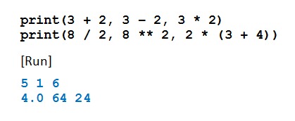
The print Function
Used to display numbers on the monitor
If n is a number, print(n) displays number n.
The print function can display the result of evaluated expressions
A single print function can display several values
Example 1: Program demonstrates operations

Slide 5
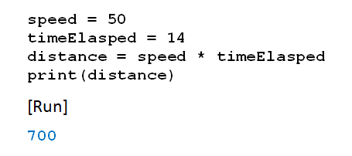
Variables
In mathematics problems, quantities are referred to by names
Names given to the values are called variables
Example 2: Program uses speed, time … calculates distance

Slide 6
Variables
Assignment statements
Expression on right evaluated
That value assigned to variable

Slide 7
Variables
Variable names in Python
Begin with letter or underscore _
Can only consist of letters, numbers, underscores
Recommend using descriptive variable names
Convention will be
Begin with lowercase
Use cap for additional “word” in the name
Example: rateOfChange

Slide 8
Variables
Names in Python are case-sensitive
There are thirty-three words, called reserved words (or keywords)
Have special meanings in Python
Cannot be used as variable names
See Appendix B

Slide 9
Comments
Comments: notes of explanation within a program
Ignored by Python interpreter
Intended for a person reading the program’s code
Begin with a # character
End-line comment: appears at the end of a line of code
Typically explains the purpose of that line

Slide 10
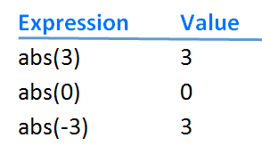
The abs Function

Slide 11
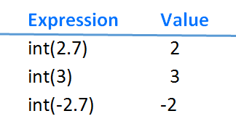
The int Function
Converts the argument into an integer

Slide 12
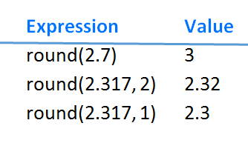
The round Function

Slide 13
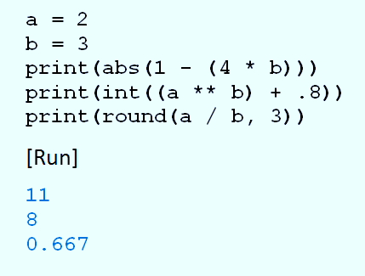
abs, int, and round Example
Example 3: Program evaluates functions, prints results

Slide 14
Augmented Assignments
Remember: expression on right side of assignment statement evaluated before assignment is made var = var + 1
Python has special operator to accomplish same thing var += 1

Slide 15
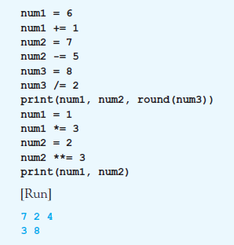
Augmented Assignments
Example 4: Program illustrates different augmented assignment operators.

Slide 16
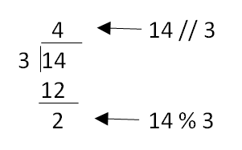
Two Other Integer Operators
Integer division operator
Written //
Modulus operator
Written %

Slide 17
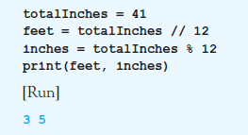
Two Other Integer Operators
Example 5: converts 41 inches to 3 feet, 5 inches:

Slide 18
Parentheses, Order of Precedence
Parentheses used to clarify meaning of an expression
Order of precedence
Terms inside parentheses (inner to outer)
Exponentiation
Multiplication, division (ordinary and integer), modulus
Addition and subtraction

Slide 19
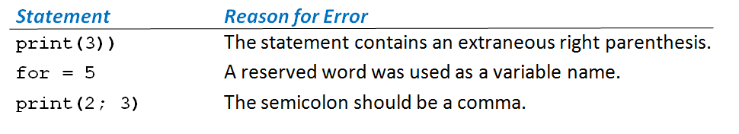
Syntax Errors
Grammatical and punctuation errors are called syntax errors.
Table 2.1 Three Syntax Errors

Slide 20
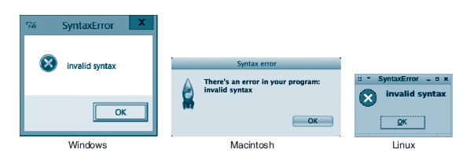
Syntax Errors
FIGURE 2.1 Syntax error message boxes.

Slide 21
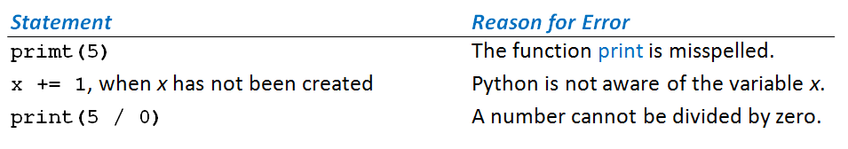
Runtime Errors
Errors discovered while program is running called runtime errors or exceptions
Table 2.2 Three Runtime Errors

Slide 22
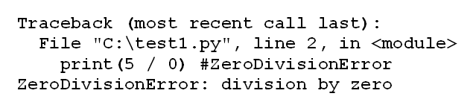
Runtime Errors
When Python encounters exception
Terminates execution of program, displays message
FIGURE 2.2 An Error Message for an Exception Error

Slide 23
Logic Error
Occurs when a program does not perform the way it was intended
Example average = firstNum + secondNum / 2
Syntax correct, logic wrong: should be average = (firstNum + secondNum) / 2
Logic errors are most difficult type of error to locate

Slide 24

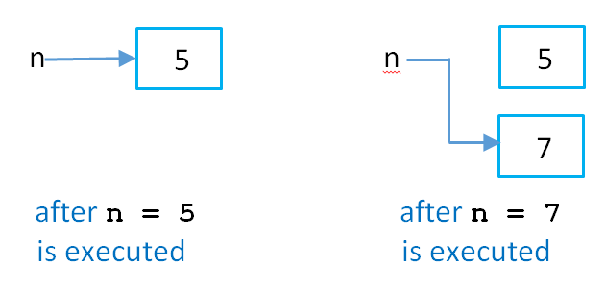
Numeric Objects in Memory
Consider this code:
This is what happens:
FIGURE 2.3 Numeric objects in memory.

Slide 25
End
Section 1
Chapter 2

